Slide 1
Create
Clear
Close
Copy
Enter
Exit
Find
Format
Get
Hide
Join
Lock
Move
Open
Optimize
Push
Pop
Redo
Remove
Rename
Reset
Resize
Search
Select
Set
Show
Skip
Split
Step
Switch
Undo
Unlock
Watch
Connect
Disconnect
Read
Receive
Send
Write
Backup
Checkpoint
Compare
Compress
Convert
ConvertFrom
ConvertTo
Dismount
Edit
Expand
Export
Group
Import
Initialize
Limit
Merge
Mount
Out
Publish
Restore
Save
Sync
Unpublish
Update
Debug
Measure
Ping
Repair
Resolve
Test
Trace
Approve
Assert
Build
Complete
Confirm
Deny
Deploy
Disable
Enable
Install
Invoke
Register
Request
Restart
Resume
Start
Stop
Submit
Suspend
Uninstall
Unregister
Wait
Use
Block
Grant
Protect
Revoke
Unblock
Unprotect
-E2EVCSessionRome2023
#PowerShell
#Jim Moyle
Notes:
https://github.com/JimMoyle/New-E2evcSessionRome2023

Slide 2
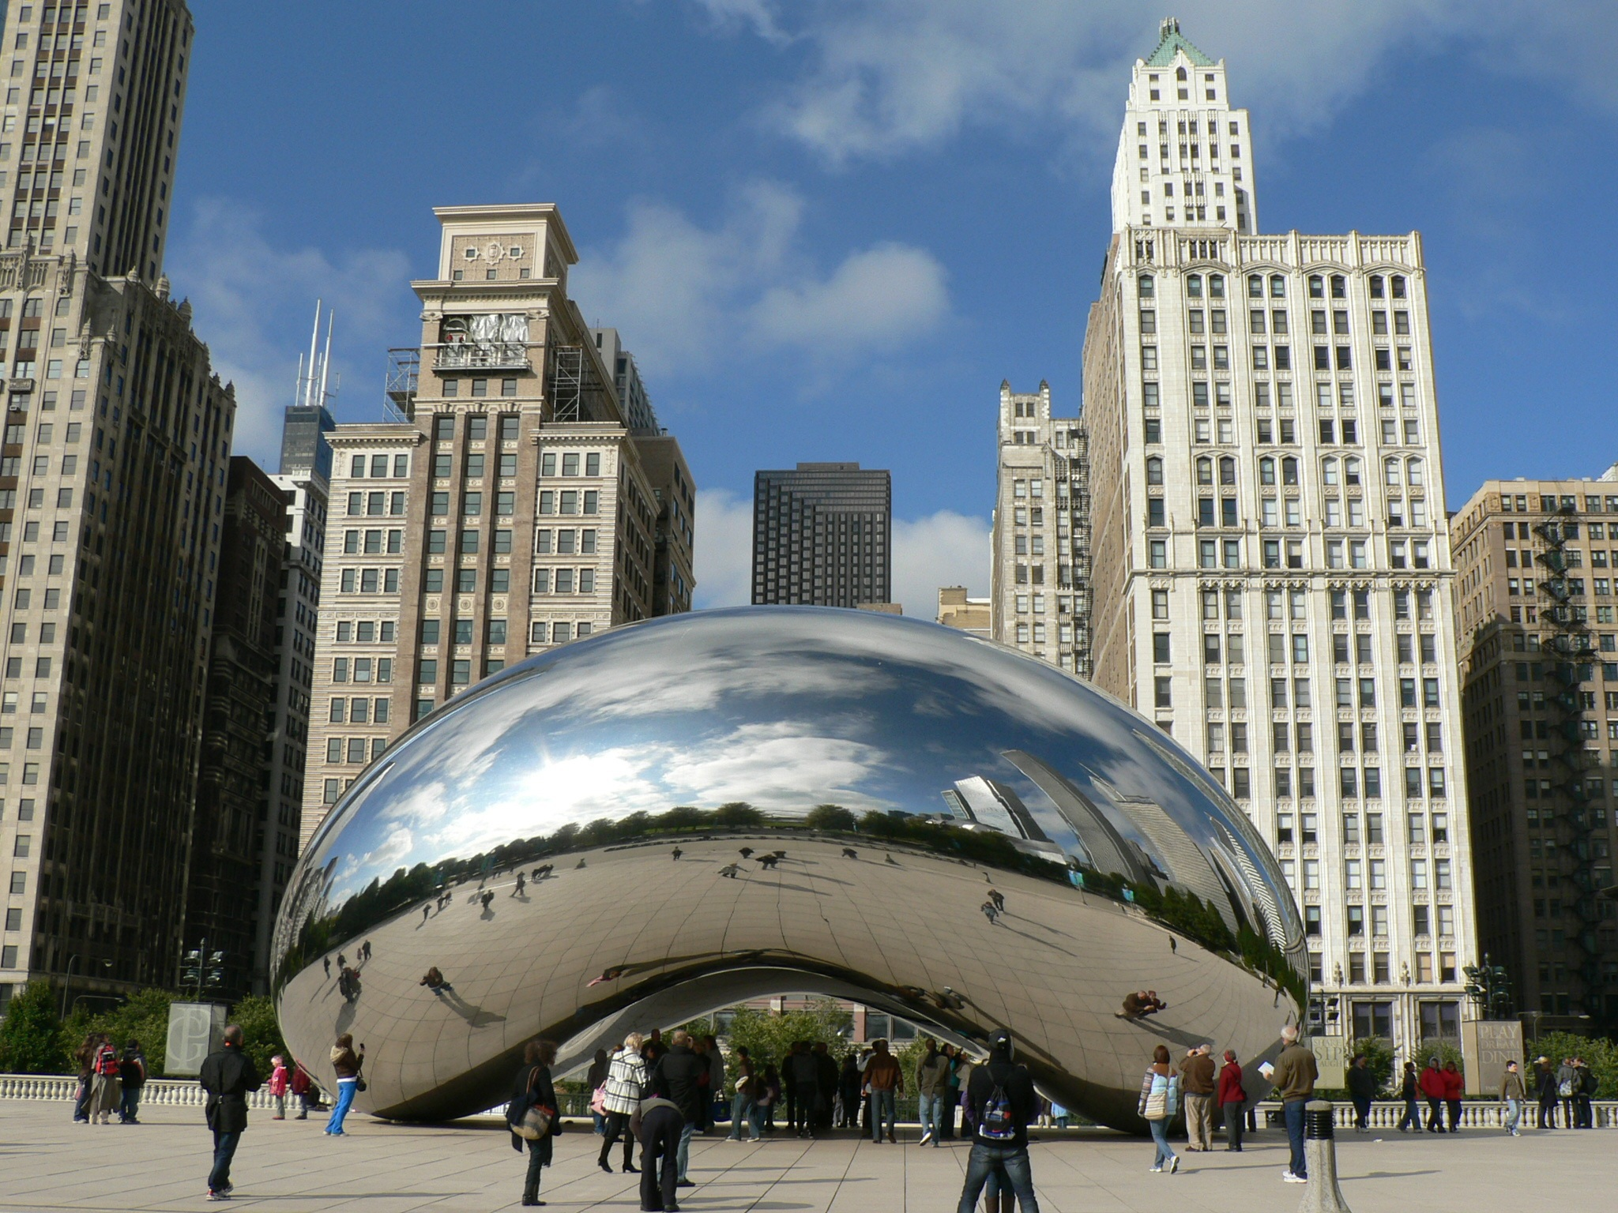
Notes:
Image by <a href="https://pixabay.com/users/elcorredor-1373851/?utm_source=link-attribution&utm_medium=referral&utm_campaign=image&utm_content=1343507">Wolfgang R. Zissler</a> from <a href="https://pixabay.com//?utm_source=link-attribution&utm_medium=referral&utm_campaign=image&utm_content=1343507">Pixabay</a>

Slide 3
Notes:
Image by <a href="https://pixabay.com/users/elcorredor-1373851/?utm_source=link-attribution&utm_medium=referral&utm_campaign=image&utm_content=1343507">Wolfgang R. Zissler</a> from <a href="https://pixabay.com//?utm_source=link-attribution&utm_medium=referral&utm_campa
When Cloud Gate's interior components were completed, construction crews prepared to work on the outer shell; this comprises 168 stainless steel panels, each 3⁄8 inch (10 mm) thick and weighing 1,000 to 2,000 pounds (450 to 910 kg).[31] They were fabricated using three-dimensional modeling software.[24] Computers and robots were essential in the bending and shaping of the plates,[25] which was performed by English wheel and a robotic scanning device.ign=image&utm_content=1343507">Pixabay</a>

Slide 4
Create
Clear
Close
Copy
Enter
Exit
Find
Format
Get
Hide
Join
Lock
Move
Open
Optimize
Push
Pop
Redo
Remove
Rename
Reset
Resize
Search
Select
Set
Show
Skip
Split
Step
Switch
Undo
Unlock
Watch
Connect
Disconnect
Read
Receive
Send
Write
Backup
Checkpoint
Compare
Compress
Convert
ConvertFrom
ConvertTo
Dismount
Edit
Expand
Export
Group
Import
Initialize
Limit
Merge
Mount
Out
Publish
Restore
Save
Sync
Unpublish
Update
Debug
Measure
Ping
Repair
Resolve
Test
Trace
Approve
Assert
Build
Complete
Confirm
Deny
Deploy
Disable
Enable
Install
Invoke
Register
Request
Restart
Resume
Start
Stop
Submit
Suspend
Uninstall
Unregister
Wait
Use
Block
Grant
Protect
Revoke
Unblock
Unprotect
-E2EVCSessionRome2023
#PowerShell
#Jim Moyle
Notes:
https://github.com/JimMoyle/New-E2evcSessionRome2023

Slide 5
Create
Clear
Close
Copy
Enter
Exit
Find
Format
Get
Hide
Join
Lock
Move
Open
Optimize
Push
Pop
Redo
Remove
Rename
Reset
Resize
Search
Select
Set
Show
Skip
Split
Step
Switch
Undo
Unlock
Watch
Connect
Disconnect
Read
Receive
Send
Write
Backup
Checkpoint
Compare
Compress
Convert
ConvertFrom
ConvertTo
Dismount
Edit
Expand
Export
Group
Import
Initialize
Limit
Merge
Mount
Out
Publish
Restore
Save
Sync
Unpublish
Update
Debug
Measure
Ping
Repair
Resolve
Test
Trace
Approve
Assert
Build
Complete
Confirm
Deny
Deploy
Disable
Enable
Install
Invoke
Register
Request
Restart
Resume
Start
Stop
Submit
Suspend
Uninstall
Unregister
Wait
Use
Block
Grant
Protect
Revoke
Unblock
Unprotect
-E2EVCSessionRome2023
#PowerShell
#Jim Moyle
Notes:
https://github.com/JimMoyle/New-E2evcSessionRome2023

Slide 6
Create
Clear
Close
Copy
Enter
Exit
Find
Format
Get
Hide
Join
Lock
Move
Open
Optimize
Push
Pop
Redo
Remove
Rename
Reset
Resize
Search
Select
Set
Show
Skip
Split
Step
Switch
Undo
Unlock
Watch
Connect
Disconnect
Read
Receive
Send
Write
Backup
Checkpoint
Compare
Compress
Convert
ConvertFrom
ConvertTo
Dismount
Edit
Expand
Export
Group
Import
Initialize
Limit
Merge
Mount
Out
Publish
Restore
Save
Sync
Unpublish
Update
Debug
Measure
Ping
Repair
Resolve
Test
Trace
Approve
Assert
Build
Complete
Confirm
Deny
Deploy
Disable
Enable
Install
Invoke
Register
Request
Restart
Resume
Start
Stop
Submit
Suspend
Uninstall
Unregister
Wait
Use
Block
Grant
Protect
Revoke
Unblock
Unprotect
-E2EVCSessionRome2023
#GitHub
#Jim Moyle
Notes:
https://github.com/JimMoyle/New-E2evcSessionRome2023

Slide 7
Create
Clear
Close
Copy
Enter
Exit
Find
Format
Get
Hide
Join
Lock
Move
Open
Optimize
Push
Pop
Redo
Remove
Rename
Reset
Resize
Search
Select
Set
Show
Skip
Split
Step
Switch
Undo
Unlock
Watch
Connect
Disconnect
Read
Receive
Send
Write
Backup
Checkpoint
Compare
Compress
Convert
ConvertFrom
ConvertTo
Dismount
Edit
Expand
Export
Group
Import
Initialize
Limit
Merge
Mount
Out
Publish
Restore
Save
Sync
Unpublish
Update
Debug
Measure
Ping
Repair
Resolve
Test
Trace
Approve
Assert
Build
Complete
Confirm
Deny
Deploy
Disable
Enable
Install
Invoke
Register
Request
Restart
Resume
Start
Stop
Submit
Suspend
Uninstall
Unregister
Wait
Use
Block
Grant
Protect
Revoke
Unblock
Unprotect
-E2EVC2023RomeJimPoSh
Notes:
https://github.com/JimMoyle/New-E2evcSessionRome2023

Slide 8
New
Clear
Close
Copy
Enter
Exit
Find
Format
Get
Hide
Join
Lock
Move
Open
Optimize
Push
Pop
Redo
Remove
Rename
Reset
Resize
Search
Select
Set
Show
Skip
Split
Step
Switch
Undo
Unlock
Watch
Connect
Disconnect
Read
Receive
Send
Write
Backup
Checkpoint
Compare
Compress
Convert
ConvertFrom
ConvertTo
Dismount
Edit
Expand
Export
Group
Import
Initialize
Limit
Merge
Mount
Out
Publish
Restore
Save
Sync
Unpublish
Update
Debug
Measure
Ping
Repair
Resolve
Test
Trace
Approve
Assert
Build
Complete
Confirm
Deny
Deploy
Disable
Enable
Install
Invoke
Register
Request
Restart
Resume
Start
Stop
Submit
Suspend
Uninstall
Unregister
Wait
Use
Block
Grant
Protect
Revoke
Unblock
Unprotect
-E2EVC2023RomeJimPoSh
#Get-Verb
Notes:
https://github.com/JimMoyle/New-E2evcSessionRome2023

Slide 9
New
Clear
Close
Copy
Enter
Exit
Find
Format
Get
Hide
Join
Lock
Move
Open
Optimize
Push
Pop
Redo
Remove
Rename
Reset
Resize
Search
Select
Set
Show
Skip
Split
Step
Switch
Undo
Unlock
Watch
Connect
Disconnect
Read
Receive
Send
Write
Backup
Checkpoint
Compare
Compress
Convert
ConvertFrom
ConvertTo
Dismount
Edit
Expand
Export
Group
Import
Initialize
Limit
Merge
Mount
Out
Publish
Restore
Save
Sync
Unpublish
Update
Debug
Measure
Ping
Repair
Resolve
Test
Trace
Approve
Assert
Build
Complete
Confirm
Deny
Deploy
Disable
Enable
Install
Invoke
Register
Request
Restart
Resume
Start
Stop
Submit
Suspend
Uninstall
Unregister
Wait
Use
Block
Grant
Protect
Revoke
Unblock
Unprotect
-E2EVC2023RomeJimPoSh
#Get-Verb
Notes:
https://github.com/JimMoyle/New-E2evcSessionRome2023

Slide 10
New
Clear
Close
Copy
Enter
Exit
Find
Format
Get
Hide
Join
Lock
Move
Open
Optimize
Push
Pop
Redo
Remove
Rename
Reset
Resize
Search
Select
Set
Show
Skip
Split
Step
Switch
Undo
Unlock
Watch
Connect
Disconnect
Read
Receive
Send
Write
Backup
Checkpoint
Compare
Compress
Convert
ConvertFrom
ConvertTo
Dismount
Edit
Expand
Export
Group
Import
Initialize
Limit
Merge
Mount
Out
Publish
Restore
Save
Sync
Unpublish
Update
Debug
Measure
Ping
Repair
Resolve
Test
Trace
Approve
Assert
Build
Complete
Confirm
Deny
Deploy
Disable
Enable
Install
Invoke
Register
Request
Restart
Resume
Start
Stop
Submit
Suspend
Uninstall
Unregister
Wait
Use
Block
Grant
Protect
Revoke
Unblock
Unprotect
-E2EVC2023RomeJimPoSh
#Get-Verb
Notes:
https://github.com/JimMoyle/New-E2evcSessionRome2023

Slide 11
New
Clear
Close
Copy
Enter
Exit
Find
Format
Get
Hide
Join
Lock
Move
Open
Optimize
Push
Pop
Redo
Remove
Rename
Reset
Resize
Search
Select
Set
Show
Skip
Split
Step
Switch
Undo
Unlock
Watch
Connect
Disconnect
Read
Receive
Send
Write
Backup
Checkpoint
Compare
Compress
Convert
ConvertFrom
ConvertTo
Dismount
Edit
Expand
Export
Group
Import
Initialize
Limit
Merge
Mount
Out
Publish
Restore
Save
Sync
Unpublish
Update
Debug
Measure
Ping
Repair
Resolve
Test
Trace
Approve
Assert
Build
Complete
Confirm
Deny
Deploy
Disable
Enable
Install
Invoke
Register
Request
Restart
Resume
Start
Stop
Submit
Suspend
Uninstall
Unregister
Wait
Use
Block
Grant
Protect
Revoke
Unblock
Unprotect
-E2EVC2023RomeJimPoSh
Notes:
https://github.com/JimMoyle/New-E2evcSessionRome2023

Slide 12
New
Clear
Close
Copy
Enter
Exit
Find
Format
Get
Hide
Join
Lock
Move
Open
Optimize
Push
Pop
Redo
Remove
Rename
Reset
Resize
Search
Select
Set
Show
Skip
Split
Step
Switch
Undo
Unlock
Watch
Connect
Disconnect
Read
Receive
Send
Write
Backup
Checkpoint
Compare
Compress
Convert
ConvertFrom
ConvertTo
Dismount
Edit
Expand
Export
Group
Import
Initialize
Limit
Merge
Mount
Out
Publish
Restore
Save
Sync
Unpublish
Update
Debug
Measure
Ping
Repair
Resolve
Test
Trace
Approve
Assert
Build
Complete
Confirm
Deny
Deploy
Disable
Enable
Install
Invoke
Register
Request
Restart
Resume
Start
Stop
Submit
Suspend
Uninstall
Unregister
Wait
Use
Block
Grant
Protect
Revoke
Unblock
Unprotect
-E2EVC2023RomeJimPoSh
Notes:
https://github.com/JimMoyle/New-E2evcSessionRome2023

Slide 13
$Pascal = "^(?:[A-Z]{1,3}(?:[a-z0-9_])+[A-Z]{0,2})+$"
E2EVC2023RomeJimPoSh –cmatch $Pascal
False
Notes:
https://github.com/JimMoyle/New-E2evcSessionRome2023

Slide 14
E2evc2023RomeJimPoSh
True
Notes:
https://github.com/JimMoyle/New-E2evcSessionRome2023

Slide 15
New-E2evc2023RomeJimPoSh
Notes:
https://github.com/JimMoyle/New-E2evcSessionRome2023

Slide 16
function Create-E2EVCSessionRome2023 {}

Slide 17
function Create-E2EVCSessionRome2023 {}
Get-Command Create-E2EVCSessionRome2023

Slide 18
function Create-E2EVCSessionRome2023 {}
Get-Command Create-E2EVCSessionRome2023
CommandType Name
----------- ----
Function Create-E2EVCSessionRome2023

Slide 19
function Create-E2EVCSessionRome2023 {}
Get-Command Create-E2EVCSessionRome2023 | format-list *
CommandType Name
----------- ----
Function Create-E2EVCSessionRome2023

Slide 20
function Create-E2EVCSessionRome2023 {}
Get-Command Create-E2EVCSessionRome2023 | fl *
CommandType Name
----------- ----
Function Create-E2EVCSessionRome2023

Slide 21
function Create-E2EVCSessionRome2023 {}
Get-Command Create-E2EVCSessionRome2023 | fl *
HelpUri :
ScriptBlock :
CmdletBinding : False
DefaultParameterSet :
Definition :
Options : None
Description :
Verb : Create
Noun : E2EVCSessionRome2023
HelpFile :
OutputType : {}
Name : Create-E2EVCSessionRome2023
CommandType : Function
Source :
Version :
Visibility : Public
ModuleName :
Module :
RemotingCapability : PowerShell
Parameters : {}
ParameterSets : {}

Slide 22
function Create-E2EVCSessionRome2023 {}
Get-Command Create-E2EVCSessionRome2023 | fl *
CmdletBinding : False
Options : None
Verb : Create
Noun : E2EVCSessionRome2023
OutputType : {}
Name : Create-E2EVCSessionRome2023
CommandType : Function
Visibility : Public
RemotingCapability : PowerShell
Parameters : {}
ParameterSets : {}

Slide 23
function Create-E2EVCSessionRome2023 {}
Get-Command Create-E2EVCSessionRome2023 | fl *
Verb : Create

Slide 24
function Create-E2EVCSessionRome2023 {}
$function = Get-Command Create-E2EVCSessionRome2023
Verb : Create

Slide 25
function Create-E2EVCSessionRome2023 {}
$function = Get-Command Create-E2EVCSessionRome2023
$function.Verb | Should -BeIn Get-Verb

Slide 26
function Create-E2EVCSessionRome2023 {}
$function = Get-Command Create-E2EVCSessionRome2023
$function.Verb | Should -BeIn ((Get-Verb).Verb)

Slide 27
function Create-E2EVCSessionRome2023 {}
$function = Get-Command Create-E2EVCSessionRome2023
It 'Must use a PowerShell approved verb.' {
$function.Verb | Should -BeIn ((Get-Verb).Verb)
}

Slide 28
function Create-E2EVCSessionRome2023 {}
$function = Get-Command Create-E2EVCSessionRome2023
Describe 'PoSh Testing' {
It 'Must use a PowerShell approved verb.' {
$function.Verb | Should -BeIn ((Get-Verb).Verb)
}
}

Slide 29
Describe 'PoSh Testing' {
BeforeAll {
function Create-E2EVCSessionRome2023 {}
$function = Get-Command Create-E2EVCSessionRome2023
}
It 'Must use a PowerShell approved verb.' {
$function.Verb | Should -BeIn ((Get-Verb).Verb)
}
}

Slide 30
Describe 'PoSh Testing' {
BeforeAll {
function Create-E2EVCSessionRome2023 {}
$function = Get-Command Create-E2EVCSessionRome2023
}
It 'Must use a PowerShell approved verb.' {
$function.Verb | Should -BeIn ((Get-Verb).Verb)
}
}
[-] PoSh Testing.Must use a PowerShell approved verb. 3ms (3ms|1ms)
Expected collection @('Add', 'Clear', 'Close', 'Copy', 'Enter', 'Exit', 'Find', 'Format', 'Get', 'Hide', ...90 more) to contain 'Create', but it was not found.

Slide 31
Describe 'PoSh Testing' {
BeforeAll {
function New-E2EVCSessionRome2023 {}
$function = Get-Command New-E2EVCSessionRome2023
}
It 'Must use a PowerShell approved verb.' {
$function.Verb | Should -BeIn ((Get-Verb).Verb)
}
}

Slide 32
Describe 'PoSh Testing' {
BeforeAll {
function New-E2EVCSessionRome2023 {}
$function = Get-Command New-E2EVCSessionRome2023
}
It 'Must use a PowerShell approved verb.' {
$function.Verb | Should -BeIn ((Get-Verb).Verb)
}
}
Describing PoSh Testing
[+] Must use a PowerShell approved verb. 9ms (2ms|8ms)
Tests completed in 65ms

Slide 33
It 'Must use a PowerShell approved verb.' {
$function.Verb | Should -BeIn ((Get-Verb).Verb)
}

Slide 34
It 'Must not use special characters in the name' {
$function.Name | Should -Not -Match '[#\(\)\{\}\[\]&/\\$\^;:"''<>|\?@`*%+=~]'
}

Slide 35
It 'Must not use special characters in the name' {
$function.Name | Should -Not -Match
}
'[#\(\)\{\}\[\]&/\\$\^;:"''<>|\?@`*%+=~]'

Slide 36
It 'Must not contain two or more hyphens in the name' {
$function.Name | Should -Not –Match '.*-.*-.*'
}

Slide 37
It 'Must use singular cmdlet Name' {
$function.Name | Should -Not –Match '.*(?:[^s|Statu|ou])s$'
}

Slide 38
It Must use Pascal Case for cmdlet name' {
$function.Name | Should -MatchExactly "^(?:[A-Z]{1,3}(?:[a-z0-9_])+[A-Z]{0,2})+-(?:[A-Z]{1,3}(?:[a-z0-9_])+[A-Z]{0,2})+$"
}

Slide 39
"^(?:[A-Z]{1,3}(?:[a-z0-9_])+[A-Z]{0,2})+-(?:[A-Z]{1,3}(?:[a-z0-9_])+[A-Z]{0,2})+$"

Slide 40
([A-Z]{1,3}(?:[a-z0-9_])+[A-Z]{0,2})+

Slide 41
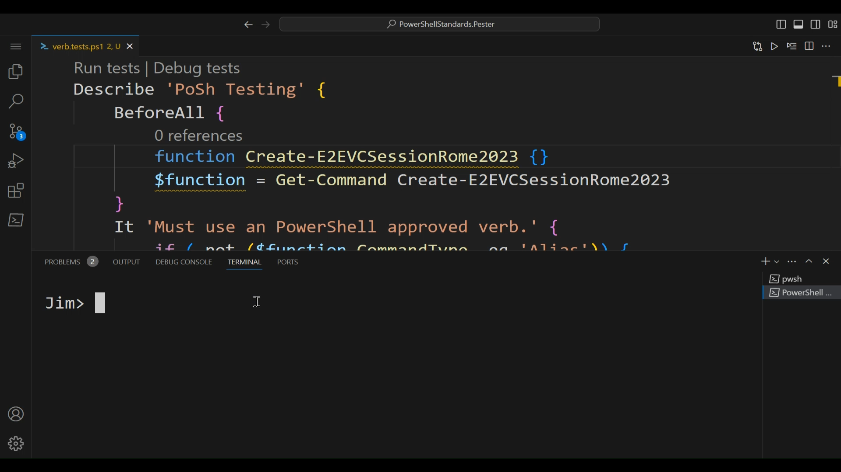
Describe 'PoSh Testing' {
BeforeAll {
function New-E2EVCSessionRome2023 {}
$function = Get-Command New-E2EVCSessionRome2023
}
It 'Must use a PowerShell approved verb.' {
$function.Verb | Should -BeIn ((Get-Verb).Verb)
}

Slide 42
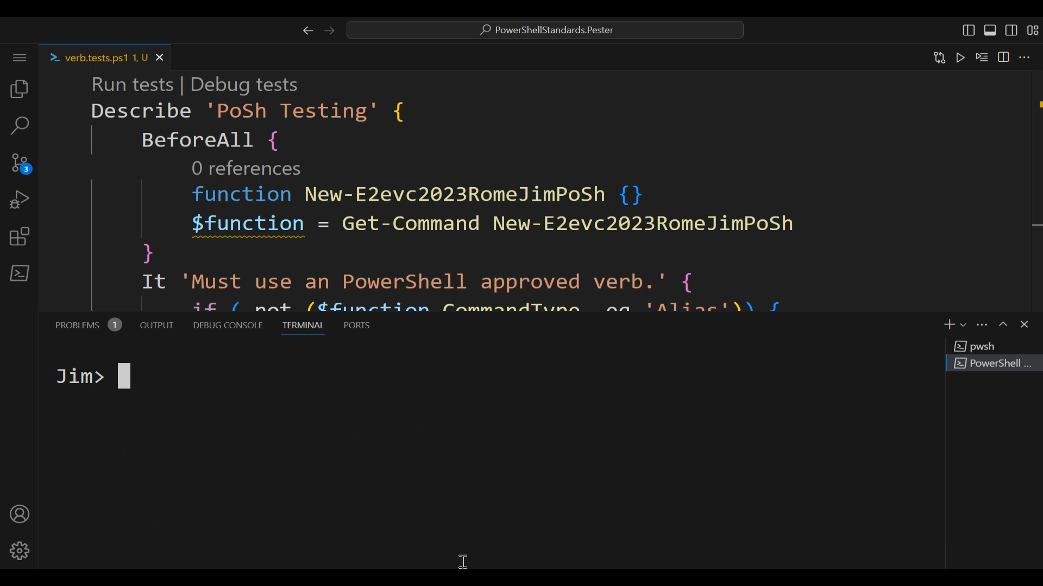
([A-Z]{1,3}(?:[a-z0-9_])+[A-Z]{0,2})+

Slide 43
It Must not use common parameter names as your own' {
$comparison = Compare-Object -ReferenceObject $badParamNames
}

Slide 44
It Must not use common parameter names as your own' {
$comparison = Compare-Object -ReferenceObject $badParamNames
$comparison | Should -BeNullOrEmpty
}

Slide 45
It Must not use common parameter names as your own’ {
if (-not ($function.CmdletBinding)) {
$comparison = Compare-Object -ReferenceObject $badParamNames
$comparison | Should –BeNullOrEmpty
}
}

Slide 46
It -Skip:$compiled Must not use common parameter names as your own’ {
if (-not ($function.CmdletBinding)) {
$comparison = Compare-Object -ReferenceObject $badParamNames
$comparison | Should –BeNullOrEmpty
}
}

Slide 47
It -Skip:$compiled Must not use common parameter names as your own’ {
if (-not ($function.CmdletBinding)) {
$comparison = Compare-Object -ReferenceObject $badParamNames
$comparison | Should –BeNullOrEmpty
}
}
if (($function.ScriptBlock | Measure-Object).Count -eq 0) {
$compiled = $true
}

Slide 48
It ‘Must have a help page uri’ {
$function.helpuri | Should -Not -BeNullOrEmpty
}

Slide 49
It ‘Has a valid help page’ {
$response = Invoke-WebRequest -Uri $function.helpuri |
Select-Object -ExpandProperty StatusCode
$response | Should -Be 200
}

Slide 50
It ‘Has a valid help page’ {
try {
$response = Invoke-WebRequest -Uri $function.helpuri |
Select-Object -ExpandProperty StatusCode
}
catch {
$response = $_.Exception.Response.StatusCode
}
$response | Should -Be 200
}

Slide 51
It ‘Has Confirm Requests for operations that modify the system’ {
if ('Stop', 'Remove', 'Revoke' -contains $function.Verb) {
$parameters.Name | Should -Contain 'Confirm’
}
}

Slide 52
It ‘Support Force Parameter for Interactive Sessions’ {
}

Slide 53
It ‘Support Force Parameter for Interactive Sessions’ {
#Absolutely no clue how to code this
}

Slide 54
It ‘Must use singular parameter name’ {
foreach ($parameter in $parameters) {
if ($parameter.ParameterType.FullName -notin 'System.Int16’,
'System.UInt16’,
'System.Int32’,
'System.UInt32’,
'System.Int64’,
'System.UInt64’,
'System.IntPtr’,
'System.UIntPtr') {
$parameter.Name -like "*s"
-and $parameter.Name
-notmatch "(Status)|(ous)|(ss)|(ics)$" |
Should -Not -BeTrue
}
}
}

Slide 55
It ‘Must use singular parameter name’ {
foreach ($parameter in $parameters) {
if ($parameter.ParameterType.FullName –not a number{
$parameter.Name -like "*s"
-and $parameter.Name
-notmatch "(Status)|(ous)|(ss)|(ics)$" |
Should -Not -BeTrue
}
}
}

Slide 56
It ‘Must use Pascal Case for parameter name’ {
$parameters.Name | Should -MatchExactly #Regex here
}

Slide 57
It ‘If possible use a standard parameter name’ {
$stdParams = Get-Content StandardParameterNames.txt
$param.Name | Should -Not –BeLike "??$stdParam"
$param.Name | Should -Not -BeLike "$stdParam??"
}

Slide 58
StandardParameterNames
Append
CaseSensitive
Command
CompatibleVersion
Compress
Compress
Continuous
Create
Delete
Drain
Erase
ErrorLevel
Exclude
Filter
Follow
Force
Include
Incremental
InputObject
Insert
Interactive
Interval
Log
NoClobber
Notify
NotifyAddress
Overwrite
Prompt
Quiet
Recurse
Repair
RepairString
Retry
Select
Stream
Strict
TempLocation
Timeout
Truncate
Verify
Wait
WaitTime
Accessed
After
Before
Created
Modified
Count
Description
From
Id
Input
Location
LogName
Name
Output
Owner
Property
Reason
Regex
Speed
State
Value
Version
All
Allocation
BlockCount
Count
Scope
Application
Assembly
Attribute
Class
Cluster
Culture
Domain
Drive
Event
Interface
IpAddress
Job
LiteralPath
Mac
ParentId
Path
Port
Printer
Size
TID
Type
URL
User
ACL
CertFile
CertIssuerName
CertRequestFile
CertSerialNumber
CertStoreLocation
CertSubjectName
CertUsage
Credential
CSPName
CSPType
Group
KeyAlgorithm
KeyContainerName
KeyLength
Operation
Principal
Privilege
Role
SaveCred
Scope
SID
Trusted
TrustLevel
DisplayName

Slide 59
It ‘If possible use a standard parameter name’ {
$param.Name | Should -Not –BeLike "??$stdParam"
$param.Name | Should -Not -BeLike "$stdParam??"
}

Slide 60
It -Tag Optional ‘If possible use a standard parameter name’ {
$param.Name | Should -Not –BeLike "??$stdParam"
$param.Name | Should -Not -BeLike "$stdParam??"
}

Slide 61
It -Tag Optional ‘If possible use a standard parameter name’ {
$stdParams = Get-Content StandardParameterNames.txt
foreach ($param in $parameters) {
if ($stdParams -notcontains $param.Name) {
foreach ($stdParam in $stdParams) {
if ($parameters.Name -notcontains $stdParam
-and $param.Name -ne "No$stdParam") {
$param.Name | Should -Not –BeLike "??$stdParam"
$param.Name | Should -Not -BeLike "$stdParam??"
}
}
}
}
}

Slide 62
It ‘Must have a Force parameter if your ConfirmImpact to high’ {
if ($function.ScriptBlock -match "ConfirmImpact"
-and $parameters.Name -contains 'Confirm') {
$parameters | Where-Object { $_.Name -eq 'Force' } |
Should -Not -BeNullOrEmpty }
}

Slide 63
It -Skip:$compiled ‘Must have a Force parameter if your ConfirmImpact to high’ {
if ($function.ScriptBlock -match "ConfirmImpact
-and $parameters.Name -contains 'Confirm') {
$parameters | Where-Object { $_.Name -eq 'Force' } |
Should -Not -BeNullOrEmpty }
}

Slide 64
It ‘Should not use the verb Invoke’ {
$function.Verb | Should -Not -Be 'Invoke’
}

Slide 65
It ‘Should not use the verb Invoke’ {
if ($function.Noun -ne 'Item’
-and $function.Noun -notlike "*script*"
-and $function.Noun -notlike "*command*"
-and $function.Noun -notlike "*method*") {
$function.Verb | Should -Not -Be 'Invoke' }
}
}

Slide 66
It ‘Do not use mandatory parameters for Get cmdlets’ {
$defaultParams |
Where-Object { $_.Attributes.Mandatory -eq $true } |
Should -BeNullOrEmpty
}

Slide 67
It ‘Do not use mandatory parameters for Get cmdlets’ {
if ($function.Verb -eq 'Get') {
$defaultParams = foreach ($param in $parameters) {
$param.ParameterSets.GetEnumerator() |
Where-Object { $_.key -eq $function.DefaultParameterSet }
$param.ParameterSets.GetEnumerator() |
Where-Object { $_.key -eq '__AllParameterSets' }
}
$defaultParams |
Where-Object { $_.Attributes.Mandatory -eq $true } |
Should -BeNullOrEmpty
}

Slide 68
It ‘Must have positional parameters for the most used inputs’ {
$positionalParams | Should -Not -BeNullOrEmpty
}

Slide 69
It ‘Must have positional parameters for the most used inputs’ {
$positionalParams = foreach ($param in $parameters) {
if ($param.Attributes.Position -ne -2147483648) {
Write-Output $param.Attributes.Position
}
}
$positionalParams | Should -Not -BeNullOrEmpty
}

Slide 70
It ‘Uses Strongly-Typed .NET Framework Types for Parameters’ {
$parameters |
Where-Object { $_.ParameterType.Name -ne "String" } |
Should -Not -BeNullOrEmpty
}

Slide 71
It ‘No Parameters That Take True and False (Boolean Version)’ {
$parameters |
Where-Object { $_.ParameterType.Name -eq 'Boolean' } |
Where-Object Name -ne 'All' | Should -BeNullOrEmpty
}

Slide 72
It ‘No Parameters That Take True and False (Validate Set)’ {
$notSwitchTest = foreach ($param in $parameters) {
if ($null -ne $param.Attributes.ValidValues) {
if ((Compare-Object $param.Attributes.ValidValues
-DifferenceObject $true, $false -IncludeEqual).Count -eq 2)
{ Write-Output 'NotSwitch' }
}
}
$notSwitchTest | Should -BeNullOrEmpty
}

Slide 73
It 'Supports pipeline input in any way.' {
$pipeParams = foreach ($param in $parameters) {
if ($param.attributes.ValueFromPipeline -eq $true -or
$param.attributes.ValueFromPipelineByPropertyName -eq $true) {
Write-Output $param.Name } }
$pipeParams | Should -Not -BeNullOrEmpty }
}

Slide 74
It 'Supports an InputObject Parameter' {
$inputObjectParams = foreach ($param in $parameters) {
if ($param.Name -eq 'InputObject') { 'InputObject' } }
$inputObjectParams | Should -Not -BeNullOrEmpty
}
}

Slide 75
It 'Test Cmdlets Should Return an object of type Boolean' {
if ($function.Verb -eq 'Test') {
$function.OutputType.Name | Should -Be 'System.Boolean' }
}
}

Slide 76
It 'If Path is a parameter it should have the PSPath alias' {
if ($parameters.Name -contains 'Path') {
$pathParam = $parameters | Where-Object { $_.Name -eq 'Path' }
$pathParam.Aliases | Should -Contain 'PSPath’
}
}

Slide 77
It -Skip:$compiled 'If Path is a parameter it should have the PSPath alias' {
if ($parameters.Name -contains 'Path') {
$pathParam = $parameters | Where-Object { $_.Name -eq 'Path' }
$pathParam.Aliases | Should -Contain 'PSPath’
}
}

Slide 78
It 'If Path is a parameter it should have the string type' {
if ($parameters.Name -contains 'Path') {
$pathParam = $parameters | Where-Object { $_.Name -eq 'Path' }
$pathParam.ParameterType.Name | Should -BeLike 'String*'
}
}

Slide 79
It 'If Uri is a parameter it should have the System.Uri type' {
if ($parameters.Name -contains 'Uri') {
$pathParam = $parameters | Where-Object { $_.Name -eq 'Uri' }
$pathParam.ParameterType.Name | Should -Be 'Uri’
}
}

Slide 80
It 'Validates input where possible (Validate Range)' {
foreach ($param in $parameters) {
#Ignoring byte types as range is implied there.
#Range needs to be Int64, so can't test 'UInt64', 'IntPtr', 'UIntPtr'
$numberTypes = @('Int16', 'UInt16', 'Int32', 'UInt32', 'Int64')
if ($numberTypes -contains $param.ParameterType.Name) {
$rangeMin = ($param.ParameterType)::MinValue
$rangeMax = ($param.ParameterType)::MaxValue
$param.Attributes.MinRange | Should -Not -BeNullOrEmpty
$param.Attributes.MaxRange | Should -Not –BeNullOrEmpty
}
}
}

Slide 81
It -Tag Optional 'Validates input where possible (Validate Range)' {
foreach ($param in $parameters) {
#Ignoring byte types as range is implied there.
#Range needs to be Int64, so can't test 'UInt64', 'IntPtr', 'UIntPtr'
$numberTypes = @('Int16', 'UInt16', 'Int32', 'UInt32', 'Int64')
if ($numberTypes -contains $param.ParameterType.Name) {
$rangeMin = ($param.ParameterType)::MinValue
$rangeMax = ($param.ParameterType)::MaxValue
$param.Attributes.MinRange | Should -Not -BeNullOrEmpty
$param.Attributes.MaxRange | Should -Not –BeNullOrEmpty
}
}
}

Slide 82
It 'Makes sure that the type described by input object is valid' {
if ($parameters.Name -contains 'InputObject') {
$inputObjectParam = $parameters |
Where-Object { $_.Name -eq 'InputObject' }
{ $inputObjectParam.ParameterType } | Should -Not -Throw
}
}

Slide 83
It 'A cmdlet should not have too many parameters’ {
$parameters.Count | Should -BeLessThan ($ParametersMax + 1)
}

Slide 84
It 'Has no more than 4 positional parameters' {
$positionalParams |
Measure-Object |
Select-Object -ExpandProperty Count |
Should -BeLessThan 5
}

Slide 85
It 'Has no more than 4 positional parameters’ {
foreach ($set in $function.ParameterSets) {
$positionalParams = foreach ($param in $set.Parameters) {
if ($param.attributes.position -ne -2147483648) {
Write-Output "Positional Parameter"
}
}
$positionalParams |
Measure-Object |
Select-Object -ExpandProperty Count |
Should -BeLessThan 5
}
}

Slide 86
It 'Each non default parameter set must have at
least one unique mandatory parameter’ {
$mandatoryParams |
Measure-Object |
Select-Object -ExpandProperty Count |
Should -BeGreaterThan 0
}

Slide 87
It 'Each non default parameter set must have at
least one unique mandatory parameter’ {
#Lots of looping through parameter sets
$mandatoryParams |
Measure-Object |
Select-Object -ExpandProperty Count |
Should -BeGreaterThan 0
}

Slide 88
It ‘No parameters with same position' {
if ($param.Attributes.position -ne -2147483648) {
$param.Attributes.position | Select-Object -First 1
}
($positionalParams | Sort-Object -Unique).Count |
Should -Be $positionalParams.Count
}

Slide 89
It ‘No parameters with same position’ {
#Lots of looping through parameter sets
if ($param.Attributes.position -ne -2147483648) {
$param.Attributes.position | Select-Object -First 1
}
($positionalParams | Sort-Object -Unique).Count |
Should -Be $positionalParams.Count
}

Slide 90
It ‘Only one parameter in a parameter set should pipe by value’ {
#Lots of looping through parameter sets
if ($param.Attributes.ValueFromPipeline -eq $true) {
Write-Output "$($param.Name)"
}
$pipeParams.Count | Should -BeLessThan 2
}

Slide 91
It ‘Support Parameter Sets when necessary’ {
#I have no clue how to measure this
}

Slide 92
It -Tag WIP ‘Support Parameter Sets when necessary’ {
#I have no clue how to measure this
}

Slide 93
It ‘Has a default Parameter set if necessary’ {
if (($function.DefaultParameterSet | Measure-Object).Count -eq 0)
#Lots of looping through parameter sets
#This is a pain to figure out
}

Slide 94
It ‘Supports arrays for Parameters where appropriate’ {
#No clue how to test this
}

Slide 95
It ‘Specify the OutputType Attribute’ {
$function.OutputType | Should -Not -BeNullOrEmpty
}

Slide 96
It ‘OutputType Attribute must be valid’ {
$typeTest = foreach ($type in $function.OutputType.Type) {
if ($null -ne $type.BaseType) {
Write-Output $type.ToString()
}
}
$typeTest | Should -Not -BeNullOrEmpty
}

Slide 97
It ‘Displays appropriate output properties by default’ {
#No clue how to test this
}

Slide 98
